Slide 1
Enrique Salgado, Humboldt Park Elizabeth Rosa-landa, Pilsen Moderator: Jimmy Prude, Auburn Gresham

Slide 2
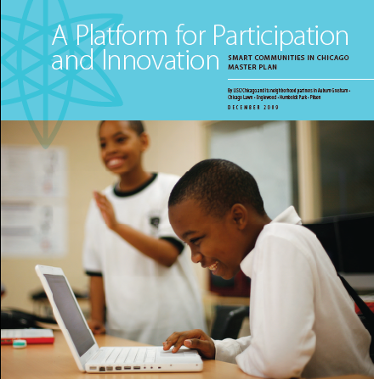
What Is A “Smart Community”

Slide 3
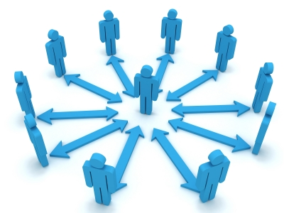
Networks of Power: Digital Literacy Meets Community Organizing in Auburn Gresham
Jimmy Prude
Community & Technology Organizer
Auburn Gresham Development Corporation

Slide 4
Auburn Gresham Digital Literacy Statistics
What Does This Mean & How Do We Mediate

Slide 5
Targeting Markets & Creating Networks Of Power
Identifying Vertical Markets
Adoption Training Markets | Location | Demographics & Numbers | Demand (High or Low) | Interventions (1:1’s) | Evaluations (How are People Learning)
Seniors
Working Families
Kids
Small Business
Non Profits
Ministers*
Schools

Slide 6
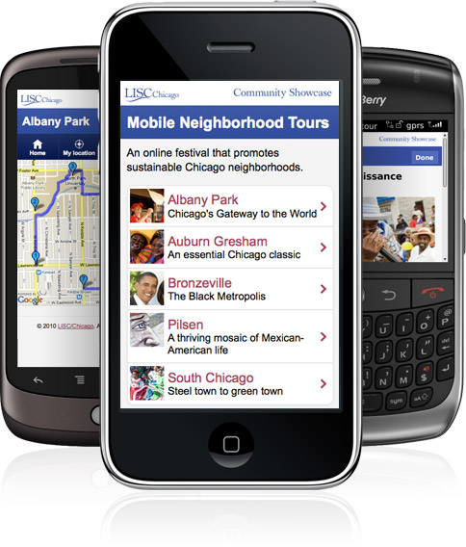
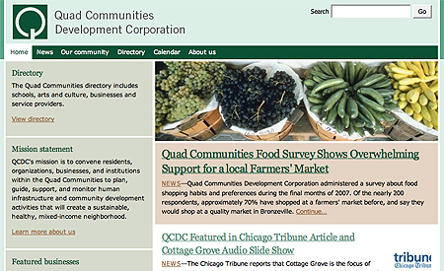
Small Business Sustainability
www.AuburnGreshamPortal.org

Slide 7
How Do We Obtain Buy In?
First: Instill HOPE
Second: Identify
Third: Ask The Questions
Who Are You
Why Are You Here
What Do You Want To Do With Technology
This Is How I Can Help You

Slide 8
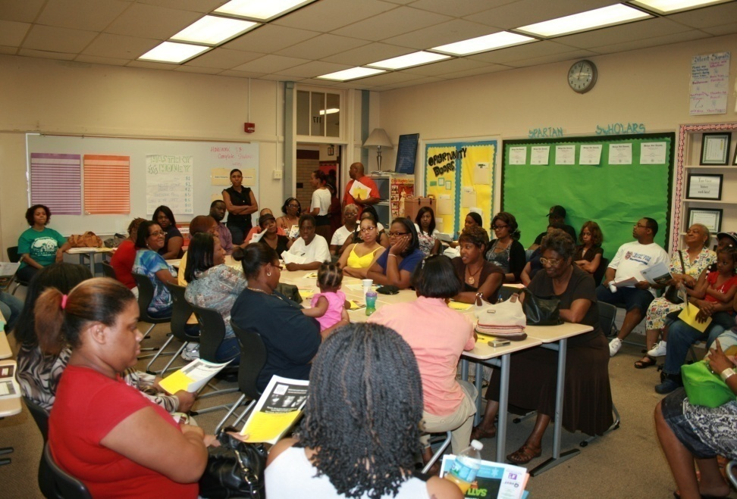
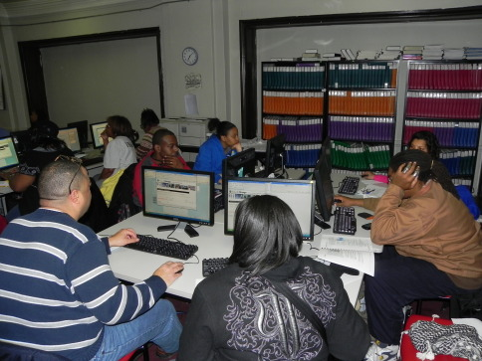
Offline-to-Online Community Organizing
Creating Good Decision Making Skills
Purchasing technology (Computers)
Do I buy High: $$$$
Do I buy Medium: $$
Do I buy Low: $
Streamlining Personal Finances
Online bill payments & E-Commerce
Paying Parking Tickets
Paying property taxes online
Online Community Organizing
Block Clubs
Parental Groups
Elected Official
Prescient Captains

Slide 9
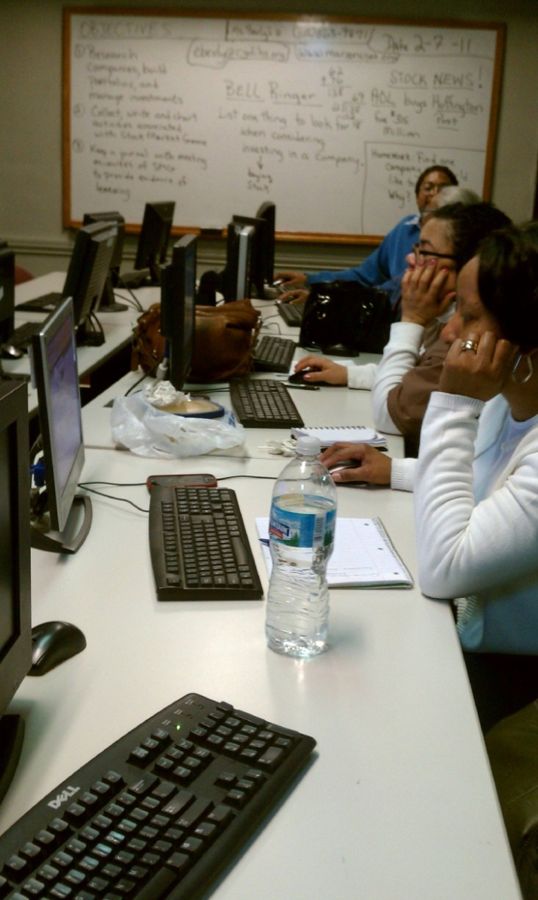
Civic Engagement In Digital Media Learning
Crime Data
Local School Test Scores
Foreclosure Data
City of Chicago City Resources
Alderman, State Rep, State Senator, Congressman, and Senator.
Ward numbers, prescient numbers, district numbers, Beat Number, Local CAPS Info
Utilizing digital media tools to build stronger communities
Facebook
YouTube
LinkedIN
Twitter
Auburn Gresham Web Portal

Slide 10
Ultimately
We Want To The Help Residents of Auburn Gresham Reach Their Full Potential and Improve The Human Condition
Another Tool In Your Tool Belt

Slide 11
Networks of Power In Auburn Gresham
Digital Literacy
Parental Groups
Block Clubs
Local Politics
Churches
“In predominantly African American communities. Black women are the most active organizational force in the Black community. The majority of the members of the black church are made up of Black women. Increasingly, Black women’s political groups are having strong impacts within the Black community. “
Oba T’Shaka.
San Francisco State University, Professor & Chair of Black Students

